Slide 1
CPSC331 - Spring 2019 Tutorial 11
Khobaib Zaamout

Slide 2
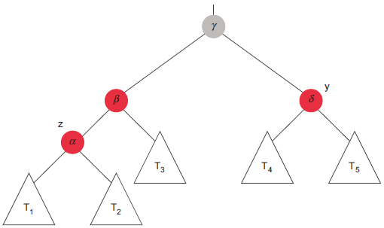
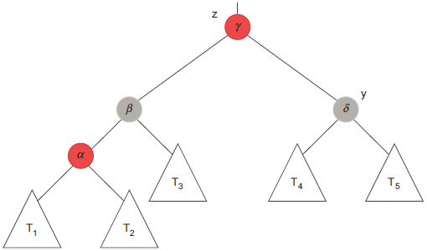
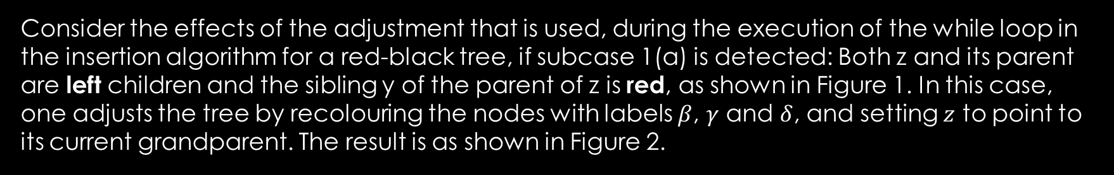
Q1
Consider the effects of the adjustment that is used, during the execution of the while loop in the insertion algorithm for a red-black tree, if subcase 1(a) is detected: Both z and its parent are left children and the sibling y of the parent of z is red, as shown in Figure 1. In this case, one adjusts the tree by recolouring the nodes with labels $β$, $γ$ and $δ$, and setting $z$ to point to its current grandparent. The result is as shown in Figure 2.
Figure 1
Figure 2

Slide 3
Q1
(a) Explain why the black-heights of all nodes in the subtrees $T_{1}$, $T_{2}$, $T_{3}$, $T_{4}$, and $T_{5}$ are still well-defined, and unchanged by the operation that is carried out.
Figure 1
Figure 2

Slide 4
Q1
(a) Explain why the black-heights of all nodes in the subtrees $T_{1}$, $T_{2}$, $T_{3}$, $T_{4}$, and $T_{5}$ are still well-defined, and unchanged by the operation that is carried out.
ANS:
Since, black-heights of all nodes in these subtrees were well-defined before the operation, and
None of these subtrees have been changed by this operation,
Then, black-heights of all nodes in these subtrees are well-defined after this operation.

Slide 5
Q1
(b) Explain why the black-heights of the nodes with labels $α$, $β$, and $δ$ are still well-defined, and unchanged, as well.
Figure 1
Figure 2

Slide 6
Q1
(b) Explain why the black-heights of the nodes with labels $α$, $β$, and $δ$ are still well-defined, and unchanged, as well.
ANS:
Since, black-heights of all nodes in these subtrees were well-defined before the operation, and
The subtrees with each of these nodes as roots have not been changed by this operation,
Then, black-heights of all nodes in these subtrees are well-defined after this operation.

Slide 7
Q1
(c) Explain why the black-height of the node with label $γ$ is increased by one, and still well-defined, as well.
Figure 1
Figure 2

Slide 8
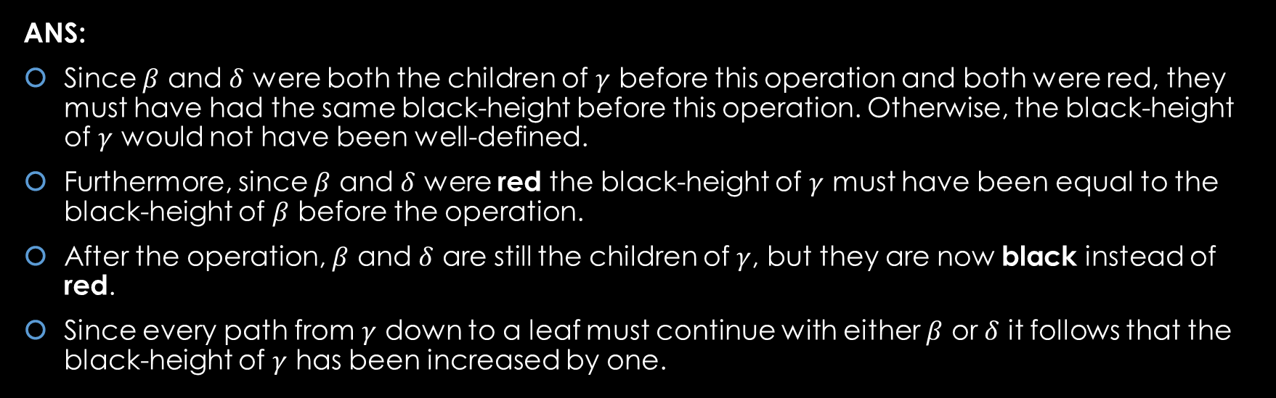
Q1
(c) Explain why the black-height of the node with label $γ$ is increased by one, and still well-defined, as well.
ANS:
Since $β$ and $δ$ were both the children of $γ$ before this operation and both were red, they must have had the same black-height before this operation. Otherwise, the black-height of $γ$ would not have been well-defined.
Furthermore, since $β$ and $δ$ were red the black-height of $γ$ must have been equal to the black-height of $β$ before the operation.
After the operation, $β$ and $δ$ are still the children of $γ$, but they are now black instead of red.
Since every path from $γ$ down to a leaf must continue with either $β$ or $δ$ it follows that the black-height of $γ$ has been increased by one.

Slide 9
Q1
(d) Explain why the black-height of every other node in this red-black tree is also well-defined and unchanged by this adjustment.
Figure 1
Figure 2

Slide 10
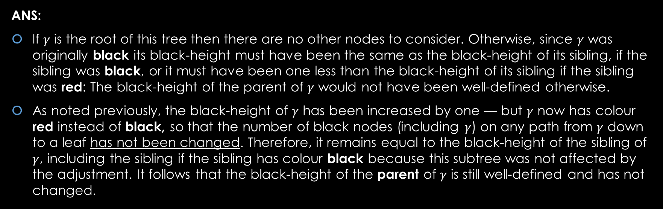
Q1
(d) Explain why the black-height of every other node in this red-black tree is also well-defined and unchanged by this adjustment.
ANS:
If $γ$ is the root of this tree then there are no other nodes to consider. Otherwise, since $γ$ was originally black its black-height must have been the same as the black-height of its sibling, if the sibling was black, or it must have been one less than the black-height of its sibling if the sibling was red: The black-height of the parent of $γ$ would not have been well-defined otherwise.
As noted previously, the black-height of $γ$ has been increased by one — but $γ$ now has colour red instead of black, so that the number of black nodes (including $γ$) on any path from $γ$ down to a leaf has not been changed. Therefore, it remains equal to the black-height of the sibling of $γ$, including the sibling if the sibling has colour black because this subtree was not affected by the adjustment. It follows that the black-height of the parent of $γ$ is still well-defined and has not changed.

Slide 11
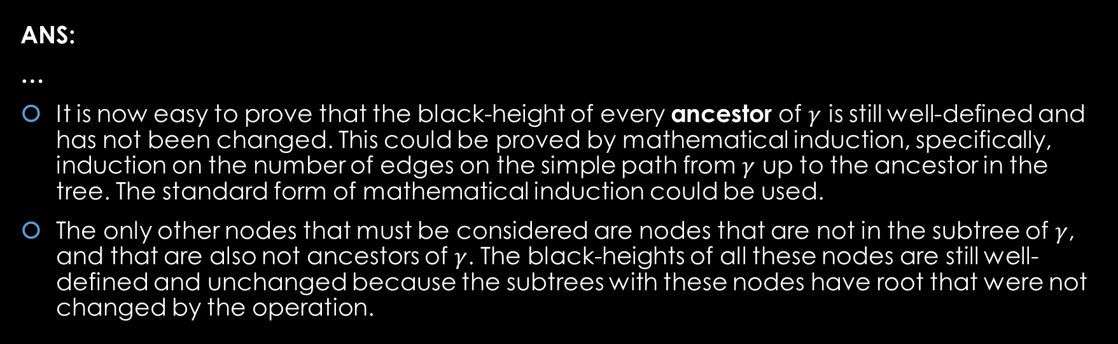
Q1
(d) Explain why the black-height of every other node in this red-black tree is also well-defined and unchanged by this adjustment.
ANS:
…
It is now easy to prove that the black-height of every ancestor of $γ$ is still well-defined and has not been changed. This could be proved by mathematical induction, specifically, induction on the number of edges on the simple path from $γ$ up to the ancestor in the tree. The standard form of mathematical induction could be used.
The only other nodes that must be considered are nodes that are not in the subtree of $γ$, and that are also not ancestors of $γ$. The black-heights of all these nodes are still well-defined and unchanged because the subtrees with these nodes have root that were not changed by the operation.

Slide 12
Q1
(e) Confirm that if $z$ pointed to the only red node in this tree with a red parent before this adjustment, then $z$ points to the only red node that might be at the root or have a red parent, after the adjustment, as well.
Figure 1
Figure 2

Slide 13
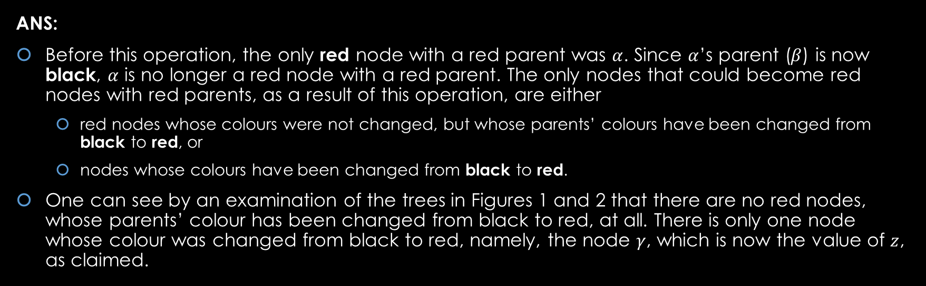
Q1
(e) Confirm that if $z$ pointed to the only red node in this tree with a red parent before this adjustment, then $z$ points to the only red node that might be at the root or have a red parent, after the adjustment, as well.
ANS:
Before this operation, the only red node with a red parent was $α$. Since $α$’s parent ($β$) is now black, $α$ is no longer a red node with a red parent. The only nodes that could become red nodes with red parents, as a result of this operation, are either
red nodes whose colours were not changed, but whose parents’ colours have been changed from black to red, or
nodes whose colours have been changed from black to red.
One can see by an examination of the trees in Figures 1 and 2 that there are no red nodes, whose parents’ colour has been changed from black to red, at all. There is only one node whose colour was changed from black to red, namely, the node $γ$, which is now the value of $z$, as claimed.

Slide 14
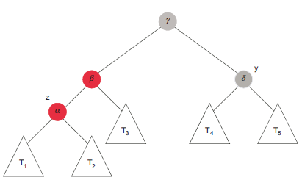
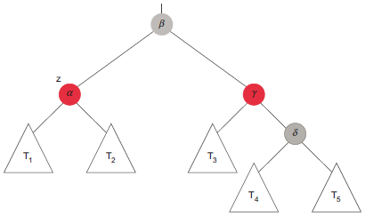
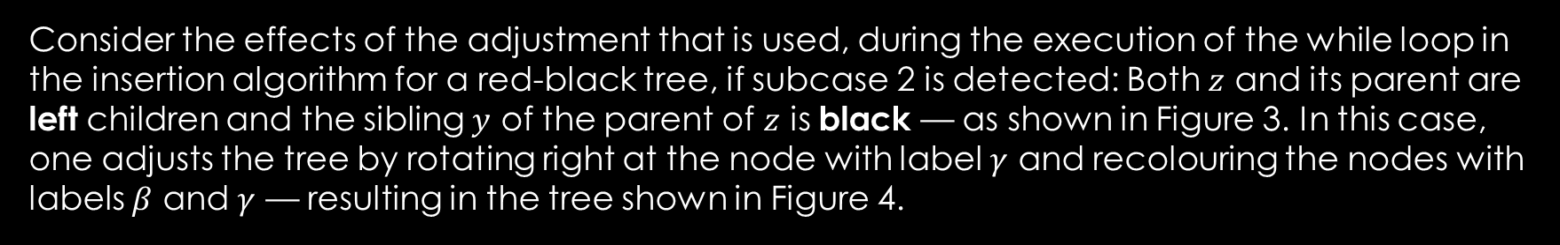
Q2
Consider the effects of the adjustment that is used, during the execution of the while loop in the insertion algorithm for a red-black tree, if subcase 2 is detected: Both $z$ and its parent are left children and the sibling $y$ of the parent of $z$ is black — as shown in Figure 3. In this case, one adjusts the tree by rotating right at the node with label $γ$ and recolouring the nodes with labels $β$ and $γ$ — resulting in the tree shown in Figure 4.
Figure 3
Figure 4

Slide 15
Q2
(a) Explain why the black-heights of all nodes in the subtrees $T_{1}$, $T_{2}$, $T_{3}$, $T_{4}$, and $T_{5}$ are still well-defined, and unchanged by this adjustment.
Figure 3
Figure 4

Slide 16
Q2
(a) Explain why the black-heights of all nodes in the subtrees $T_{1}$, $T_{2}$, $T_{3}$, $T_{4}$, and $T_{5}$ are still well-defined, and unchanged by this adjustment.
ANS:
Since, black-heights of all nodes in these subtrees were well-defined before the operation, and
None of these subtrees have been changed by this operation,
Then, black-heights of all nodes in these subtrees are well-defined after this operation.

Slide 17

Q2
(b) Assuming that the black-heights of nodes were all initially well-defined, you are asked to confirm that:
$$bh(α)=bh(β)=bh(γ)=bh(δ)+1$$
before this adjustment.
Figure 3
Figure 4

Slide 18

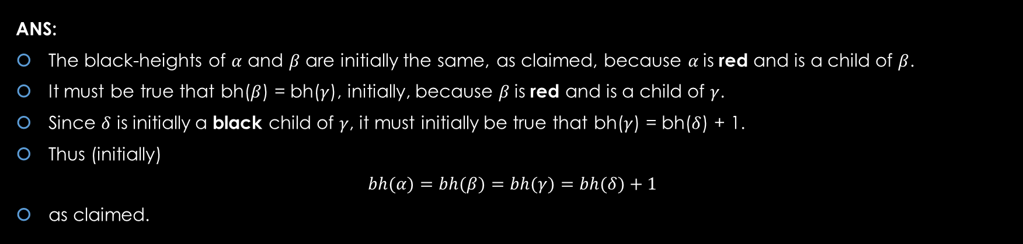
Q2
(b) Assuming that the black-heights of nodes were all initially well-defined, you were asked to confirm that:
$$bh(α)=bh(β)=bh(γ)=bh(δ)+1$$
before this adjustment.
ANS:
The black-heights of $α$ and $β$ are initially the same, as claimed, because $α$is red and is a child of $β$.
It must be true that bh($β$) = bh($γ$), initially, because $β$is red and is a child of $γ$.
Since $δ$ is initially a black child of $γ$, it must initially be true that bh($γ$) = bh($δ$) + 1.
Thus (initially)
$$bh(α)=bh(β)=bh(γ)=bh(δ)+1$$
as claimed.

Slide 19
Q2
(c) Using this information, confirm that the black-heights of $α$ and $δ$ are both well-defined, and unchanged, after this operation is carried out.
Figure 3
Figure 4

Slide 20

Q2
(c) Using this information, confirm that the black-heights of $α$ and $δ$ are both well-defined, and unchanged, after this operation is carried out.
ANS:
The subtrees with roots $α$ and $δ$ have not been changed. So, the black-heights of $α$ and $δ$ are well-defined and unchanged as well.

Slide 21
Q2
(d) Using the above information, confirm that the black-height of $γ$ is also well-defined and unchanged by this adjustment.
Figure 3
Figure 4

Slide 22
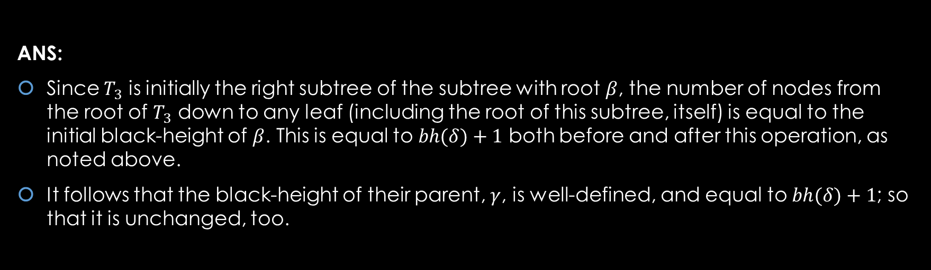
Q2
(d) Using the above information, confirm that the black-height of $γ$ is also well-defined and unchanged by this adjustment.
ANS:
Since $T_{3}$ is initially the right subtree of the subtree with root $β$, the number of nodes from the root of $T_{3}$ down to any leaf (including the root of this subtree, itself) is equal to the initial black-height of $β$. This is equal to $bh(δ)+1$ both before and after this operation, as noted above.
It follows that the black-height of their parent, $γ$, is well-defined, and equal to $bh(δ)+1$; so that it is unchanged, too.

Slide 23
Q2
(e) Using this information, as well, confirm that the black-height of is still well-defined and also unchanged by this adjustment.
Figure 3
Figure 4

Slide 24
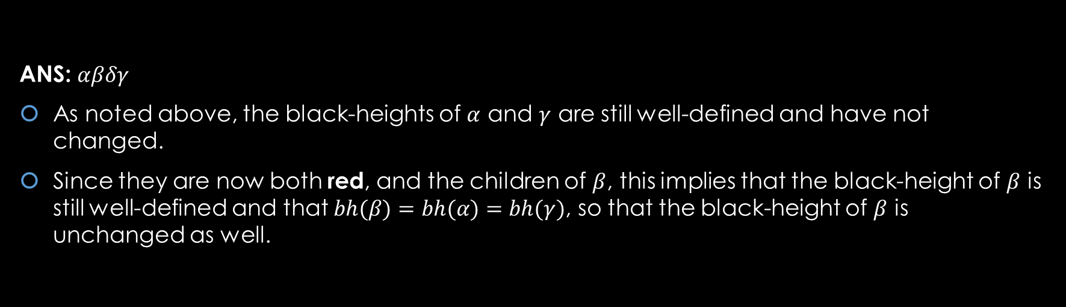
Q2
(e) Using this information, as well, confirm that the black-height of is still well-defined and also unchanged by this adjustment.
ANS: $αβδγ$
As noted above, the black-heights of $α$ and $γ$ are still well-defined and have not changed.
Since they are now both red, and the children of $β$, this implies that the black-height of $β$ is still well-defined and that $bh(β)=bh(α)=bh(γ)$, so that the black-height of $β$ is unchanged as well.

